Slide 1
The Walled Off Hotel
Made by Banksy

Slide 2
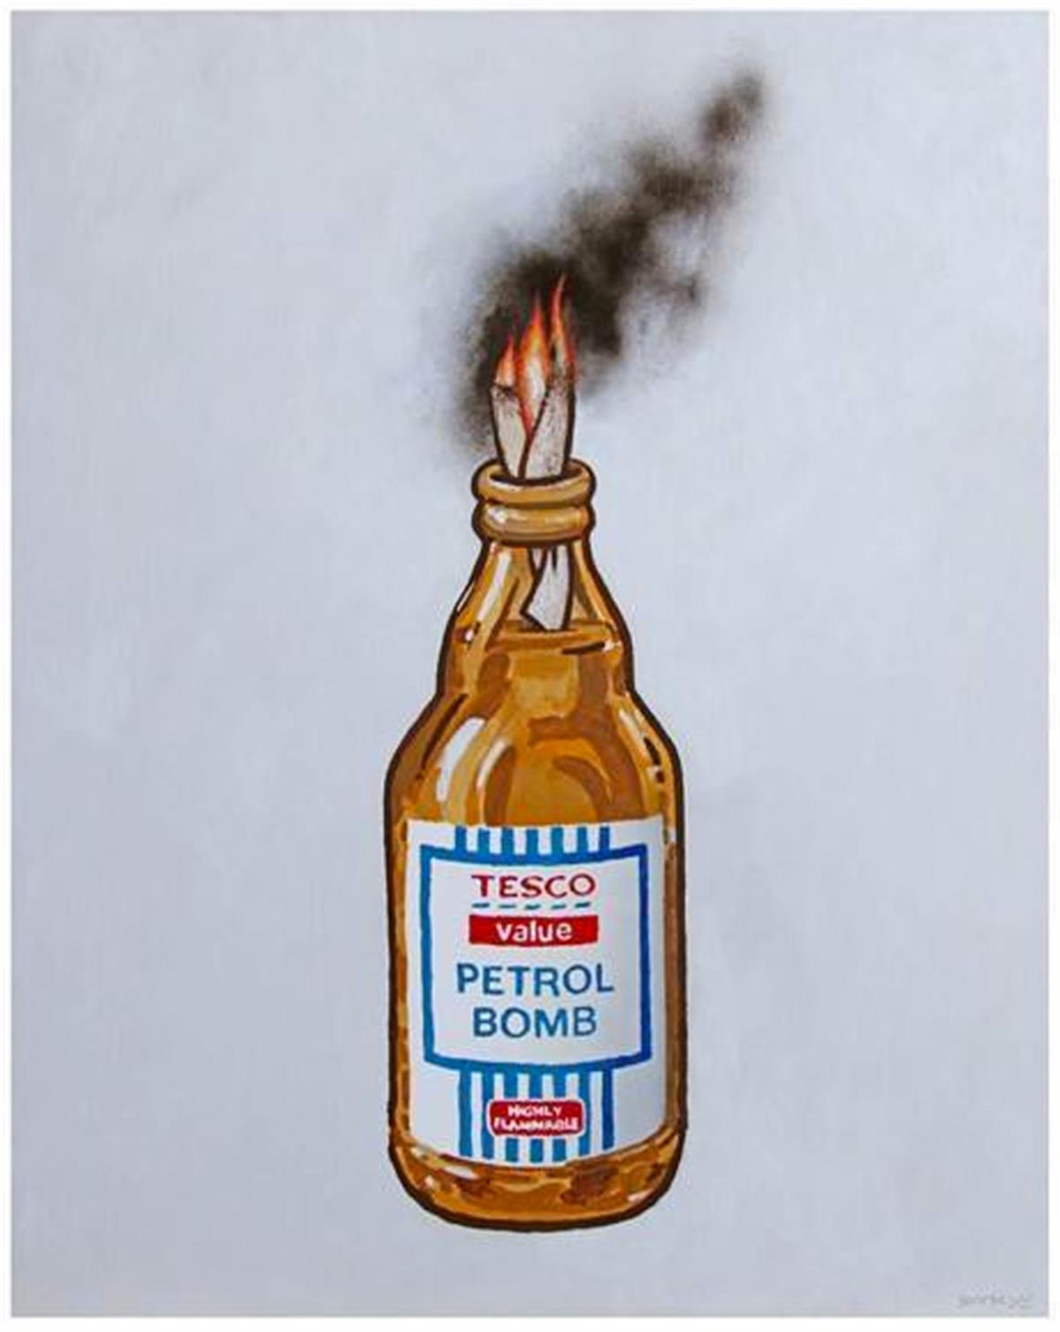
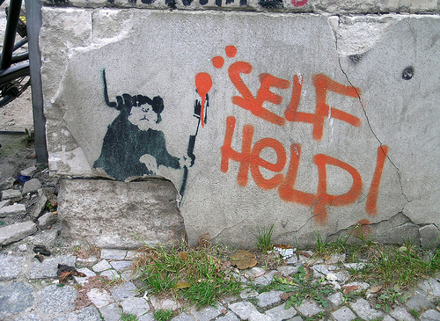
Who is Banksy?
We already know!

Slide 3
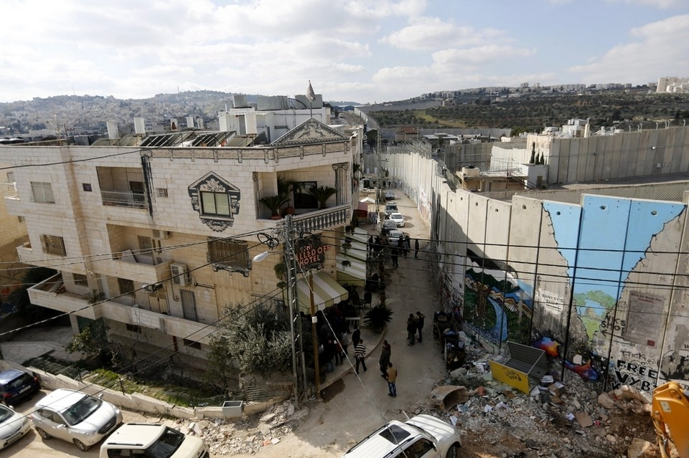
Notes:
Graffiti was created in 2003.
Jerusalem. Palestine, Bethlehem. Near with the Wall between Palestine and Israel.
Photo was made in 2005.

Slide 4
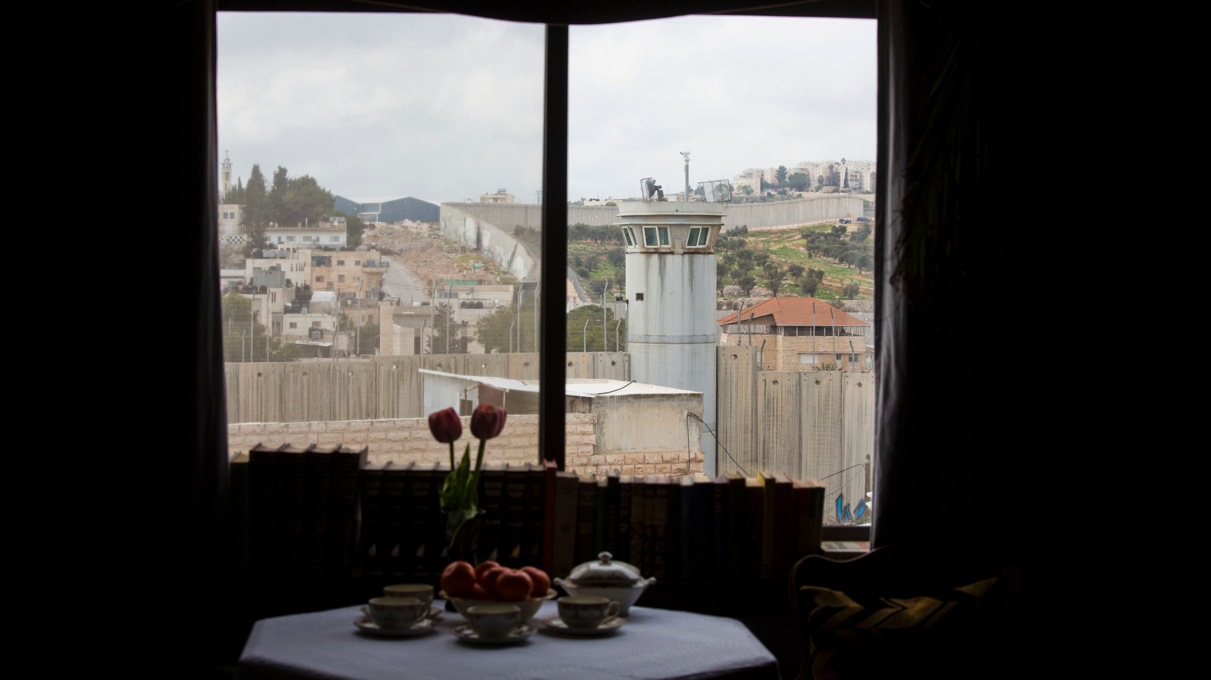

Slide 5
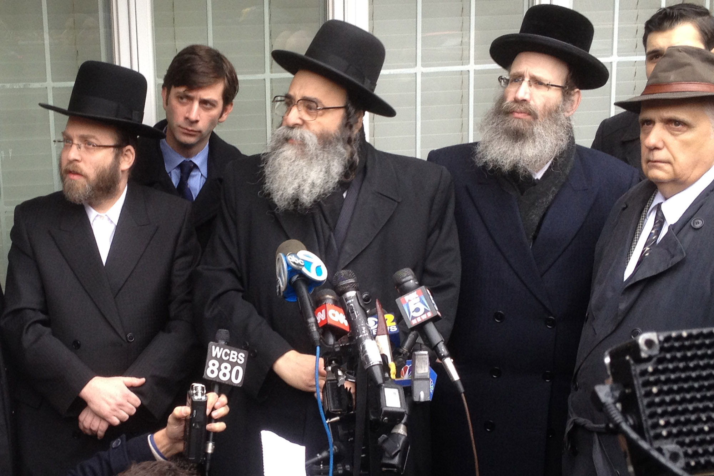
For whom?

Slide 6
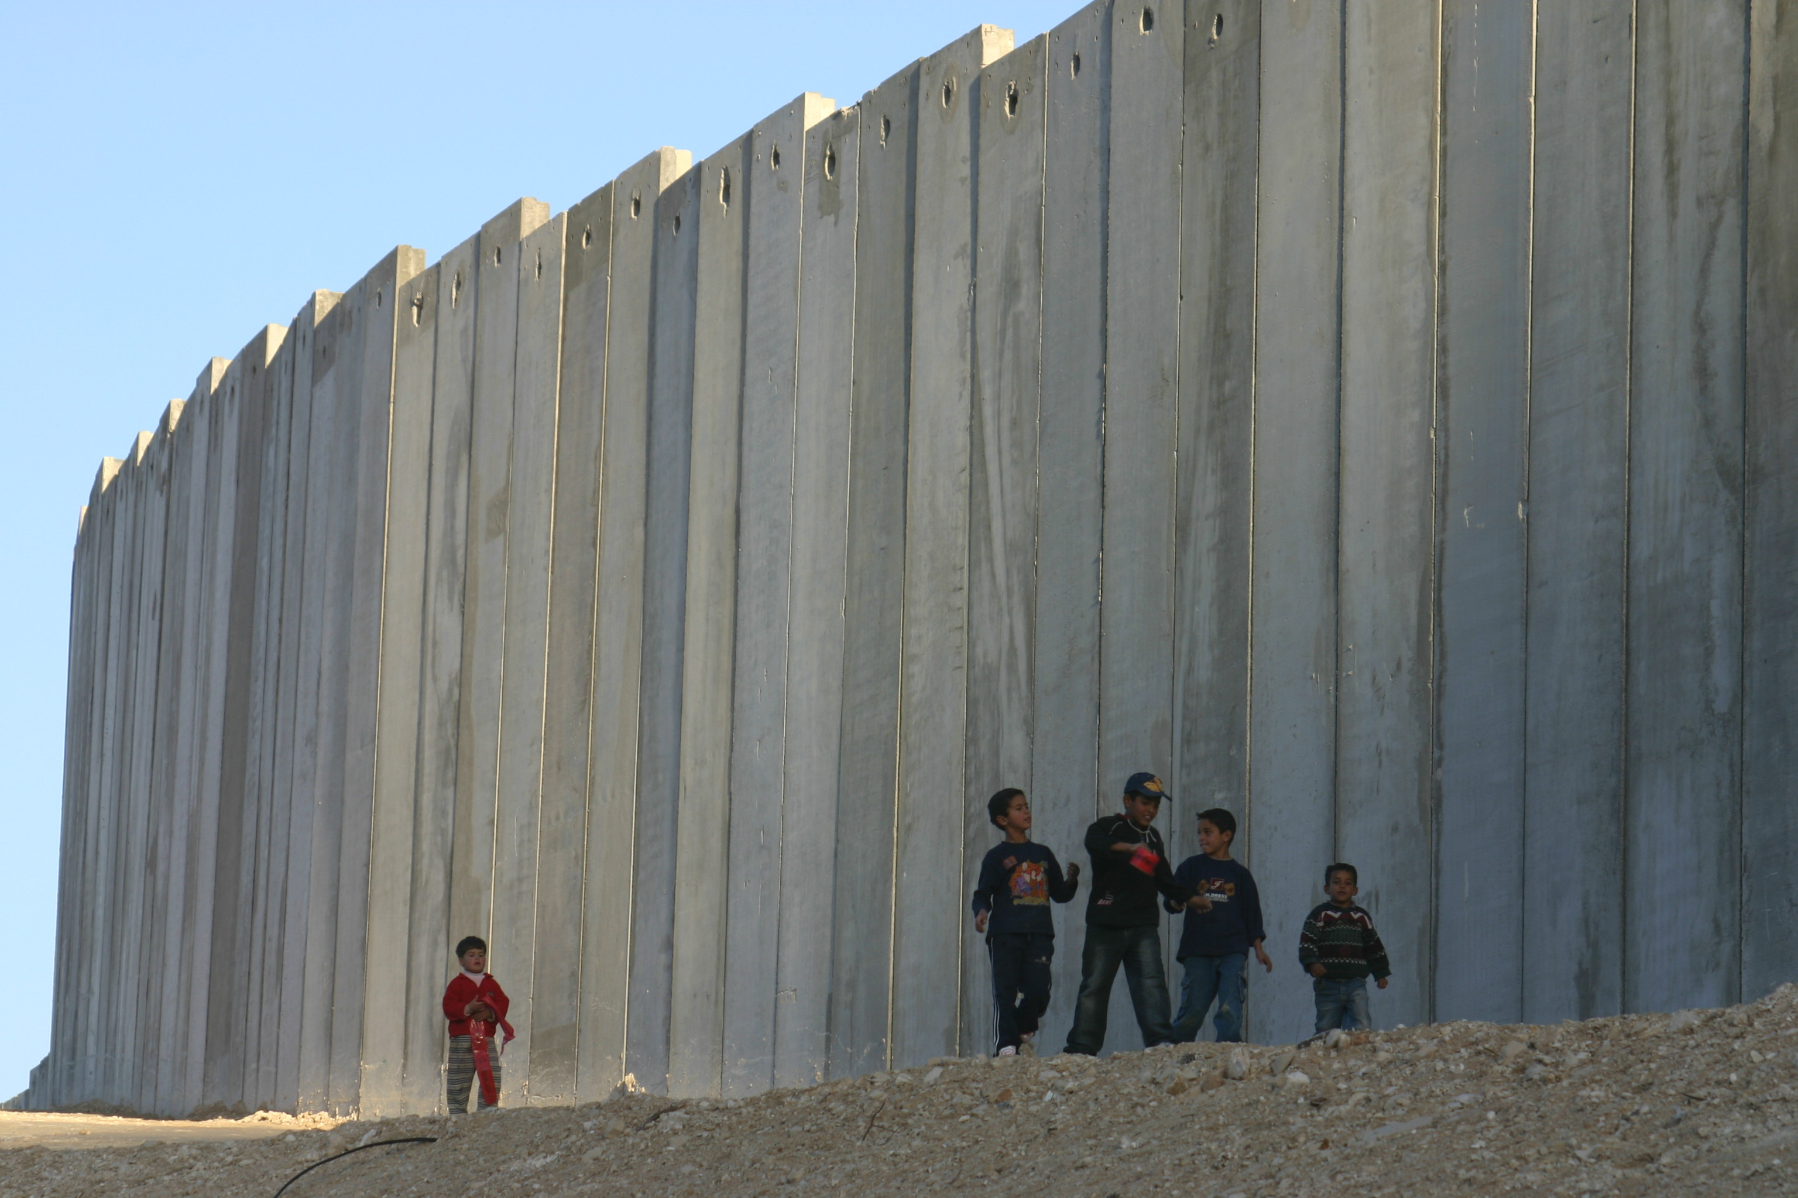
What for?
Notes:
the ongoing Palestinian-Israeli confrontation.

Slide 7
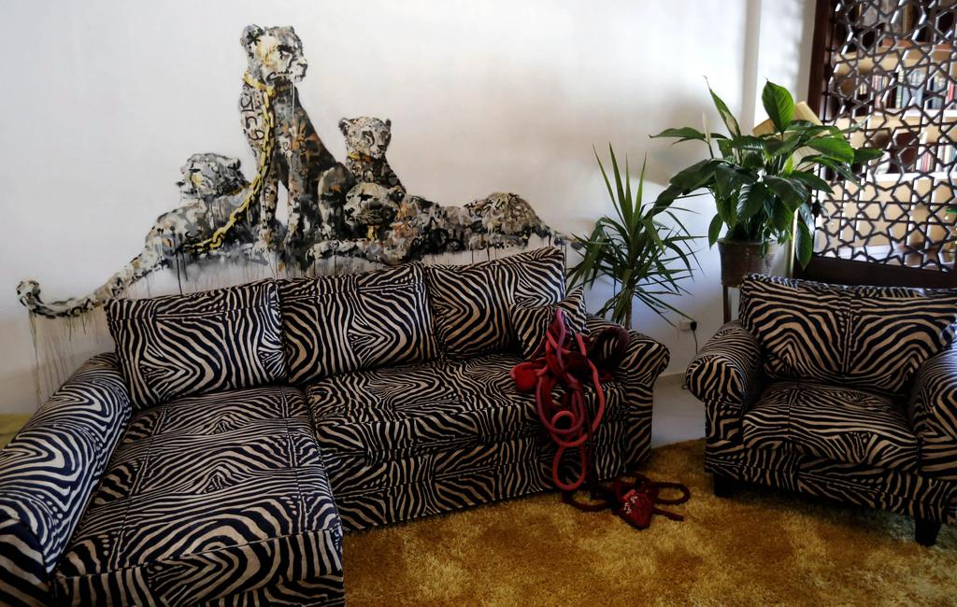
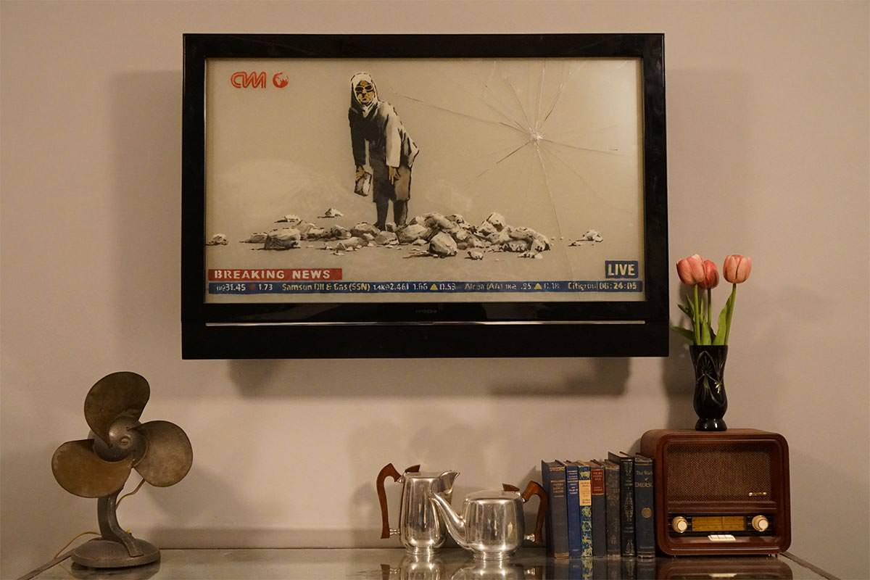
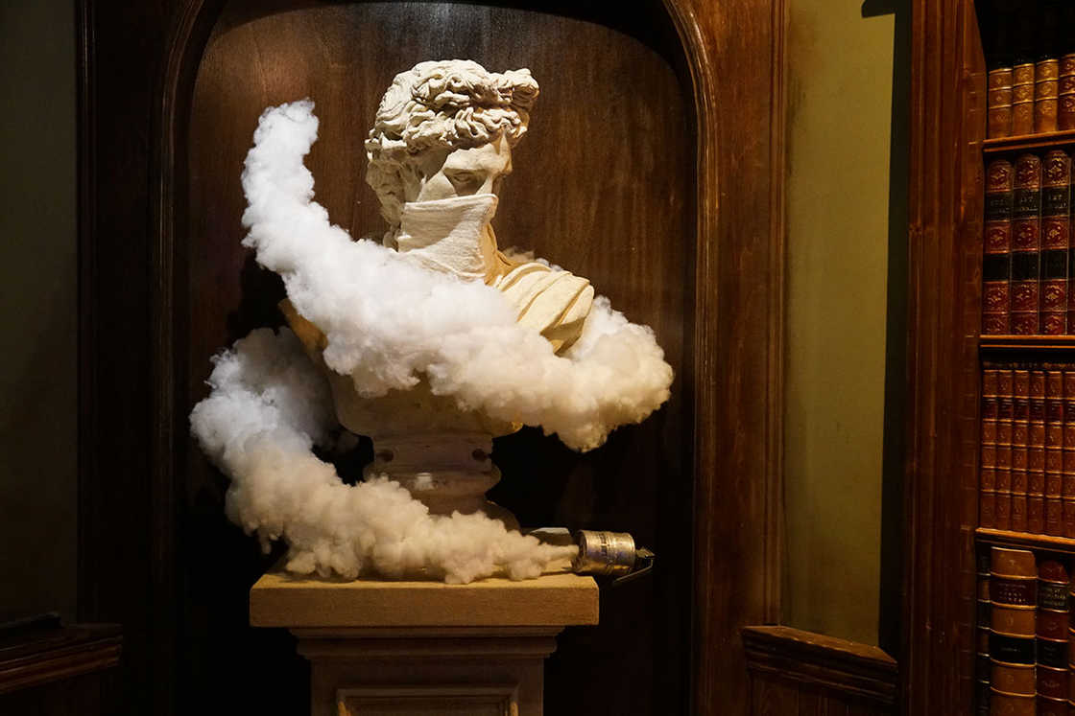
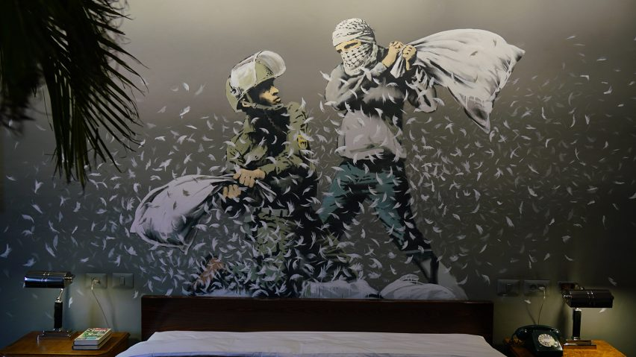
Can it be just a business?

Slide 8
Thanks for attention!

